Slide 1
Optimized CNN for Cancerous Histopathologic Image Classification
Sun Jiao

Slide 2
Contents:
Background :
-Histopathologic images
-Cancerous cells
-Image Classification algorithms
-CNN
-Optimizers

Slide 3
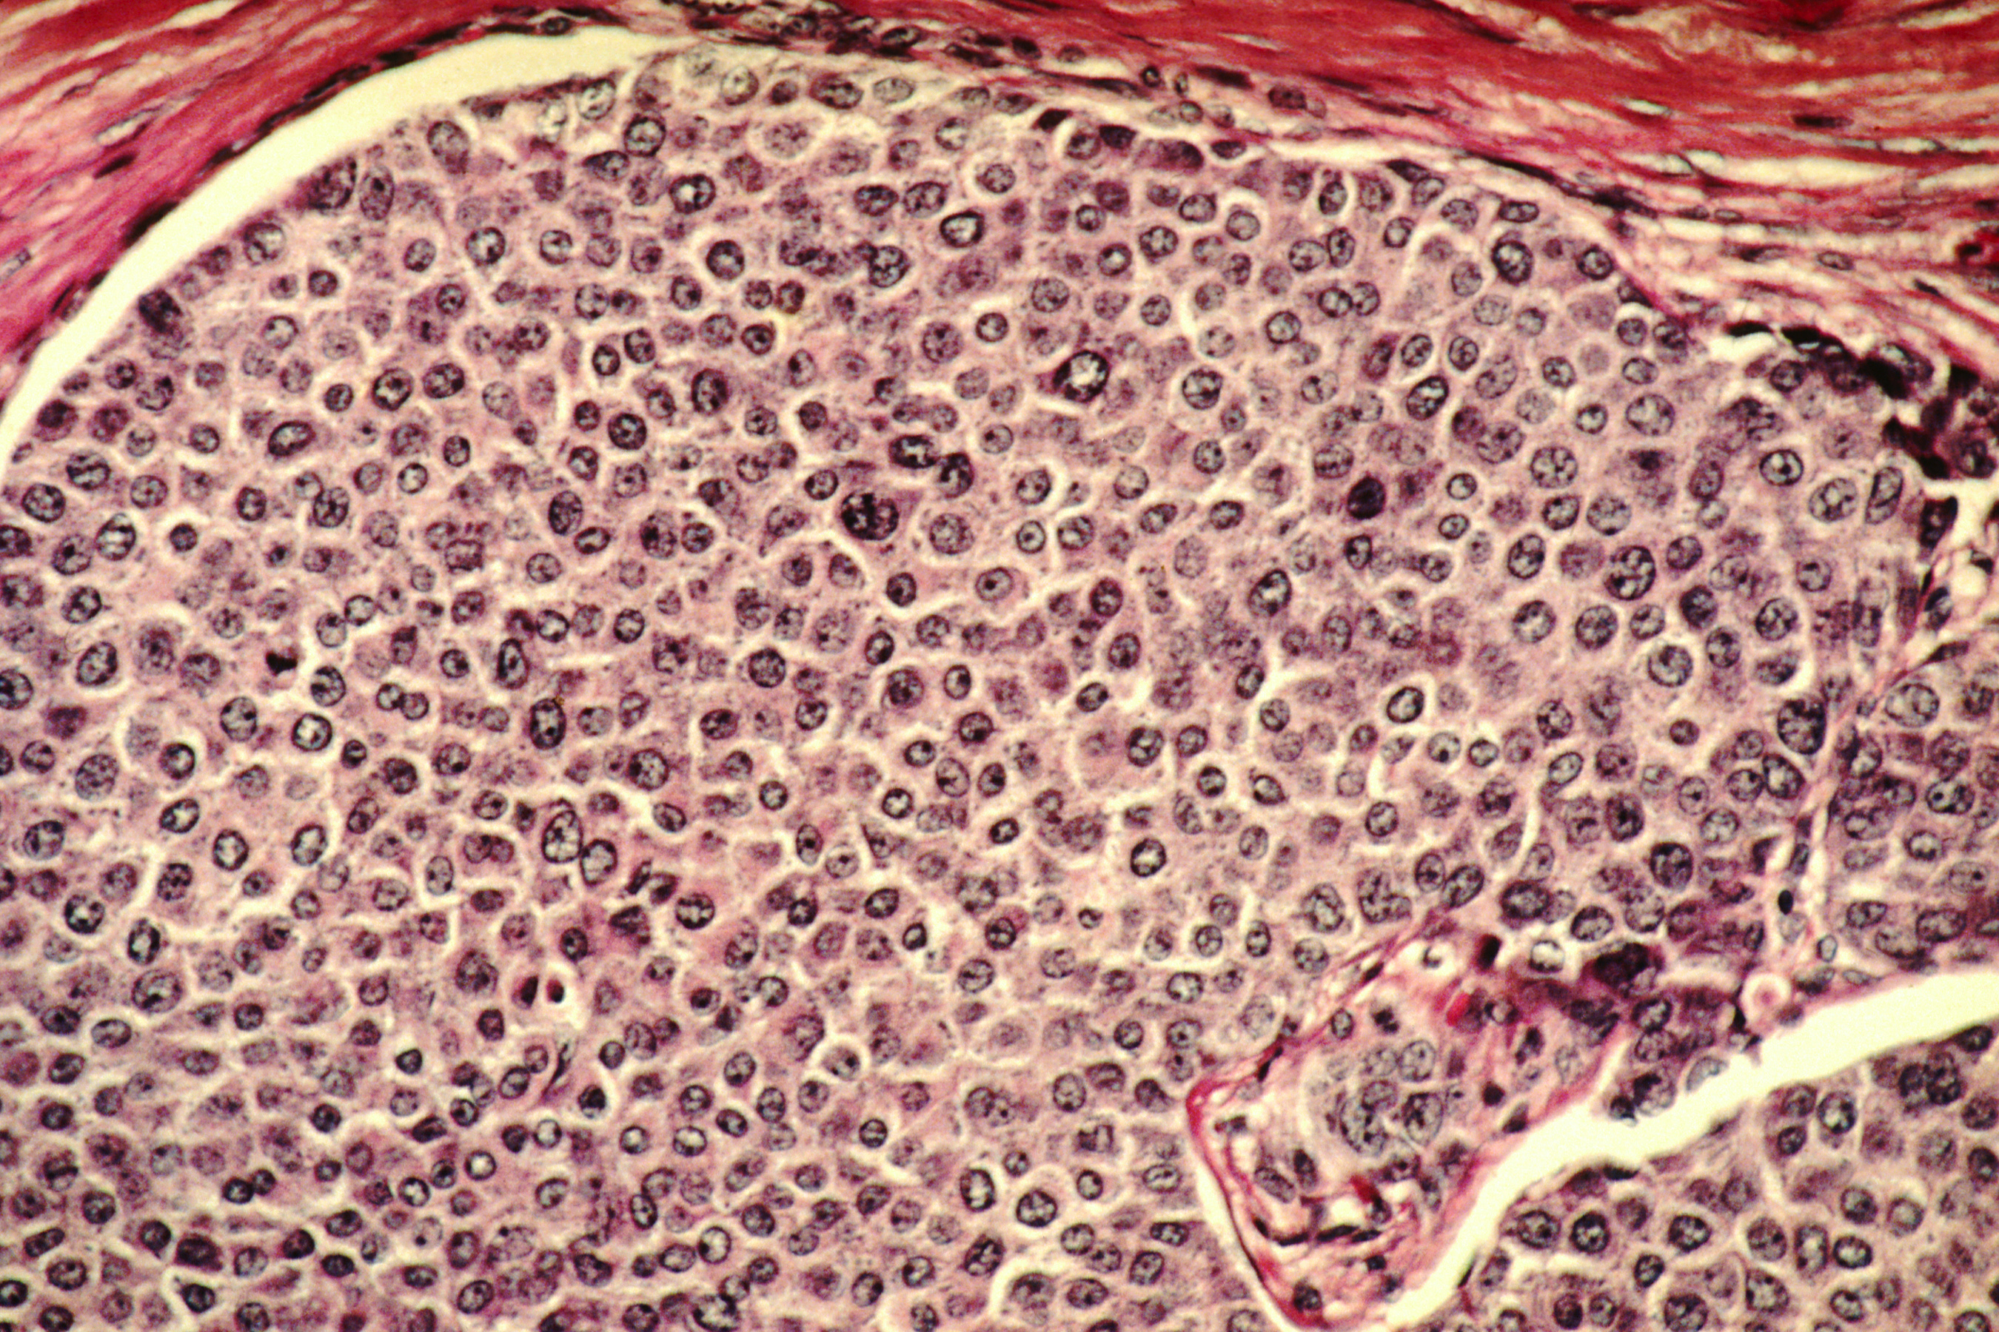
What is Histopathologic image and Cancerous cell
Histology --- tissues
Histopathology
Pathology--- disease
microscope
cells that divide relentlessly
spread from one part of the body to another
Spread easily
Breast cancer cell

Slide 4
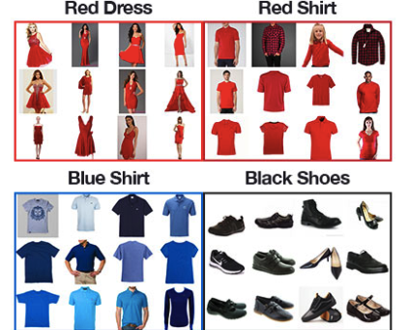
Image Classification
height
256*256*3
Computer see
What we see
width
binary classification（0/1）
Multiply -classification

Slide 5
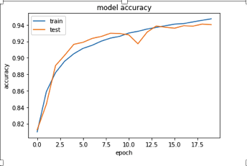
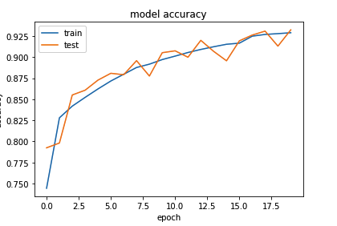
radam
SGD

Slide 6
ONE Convolution +Pooling
1 convolution layer repeat 3 times
1 | 0 | 1
1 | 0 | -1
1 | 0 | -1
input
1 | 0 | 1
1 | 0 | -1
1 | 0 | -1
1 | 0 | 1
1 | 0 | -1
1 | 0 | -1
96-3+1(bias)
96*96
1 | 0 | 1
1 | 0 | -1
1 | 0 | -1
1 | 0 | 1
1 | 0 | -1
1 | 0 | -1
94*94
92*92
1 | 0 | 1
1 | 0 | -1
1 | 0 | -1
90*90
1 | 0 | 1
1 | 0 | -1
1 | 0 | -1
filters
filters
32
filters
Prevent overfitting
45*45
Maxpool
dropout
OUTPUT

Slide 7
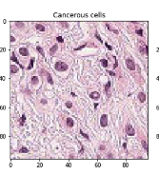
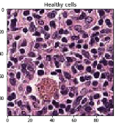
Fully connection layer
Out put
Convolution layers
Flatten layer
dense layer
dropout

